Slide 1
Green CHIPS Community Investment Fund Workshop
August 2024

Slide 2
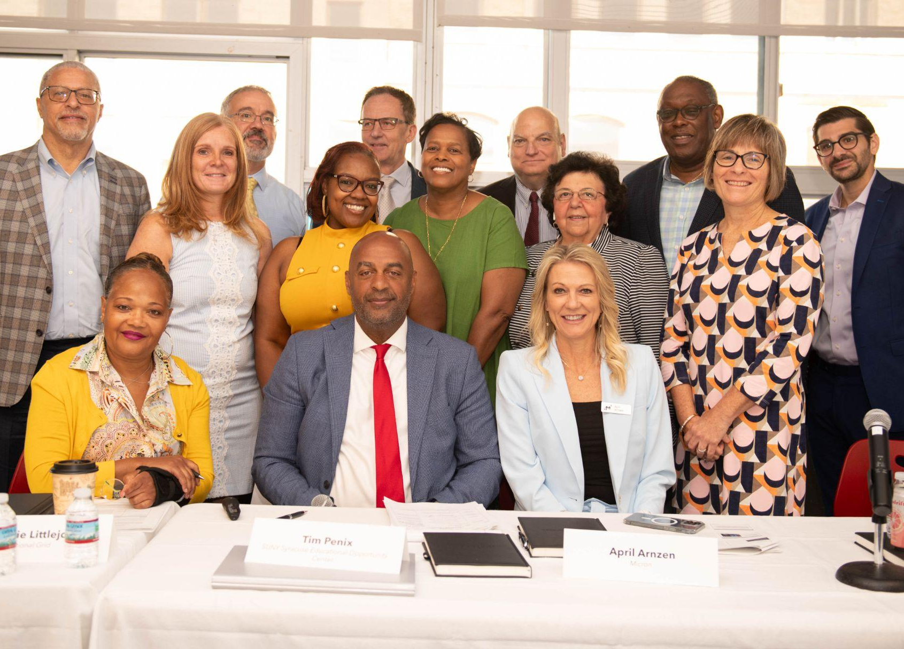
CEC Mission Statement:
The Community Engagement Committee (CEC) is dedicated to identifying community priorities and creating a framework for directing investments across key sectors, to ensure Central New York remains a vibrant place to live, work, and flourish for generations to come.
Through comprehensive engagement methods, fostering ground-up participation and channelling the power of collective insight, we aim to actively gather feedback from Central New York's diverse community, ensuring every voice is acknowledged and considered.

Slide 3
The voices that shaped the Community Priorities Document
12,752
316+
50
Total Participants Reached*
Organizations Engaged
Total Events**
399
902
3,274
3,239
4,920
Public Meeting Attendees
Participants in 1:1 Interviews, Focus Groups, and Other Events
Postcards Distributed While Canvassing
Survey Responses
Unique Website Visitors and Email Subscribers
*18 CEC Members included in this number
**Focus Groups, Public Meetings, and other events
Notes:
Source: https://docs.google.com/spreadsheets/d/1cfKgSdAI5klYUm9htvF9DYG4-VQJYw_U6gpnh9BwTiw/edit#gid=1953548029
Note: survey numbers went lower from last iteration after survey cleaning

Slide 4
Core Considerations of the Community Priorities Document (CPD)
Impact on Vulnerable Populations
Economic Return on Investment
Feasibility Assessment
Community Demand & Support
Alignment with Strategic Goals
Sustainability & Long-Term Viability

Slide 5
Community Priorities Document Guiding Principles
Data Driven & Community-Centered Approach
Transparency
Equitable Development
Diversity Enhancement
Smart Growth
Good Jobs
Sustainability & Adaptability

Slide 6
Community Priorities Document
Priority Areas
Educational Resources and Access
Workforce Exposure, Development, and Job Opportunities
Minority-, Women-, Veteran-Owned Business Enterprises and Small Businesses​
Housing, Community Development, and Quality of Place
Community Health and Family Supports
Sustainable and Equitable Infrastructure Development

Slide 7
Priorities in the CPD
K-12 EDUCATIONAL RESOURCES AND ACCESS​
WORKFORCE EXPOSURE, DEVELOPMENT, AND JOB OPPORTUNITIES
MINORITY-, WOMEN-, VETERAN-OWNED BUSINESS ENTERPRISES AND SMALL BUSINESSES
HOUSING, COMMUNITY DEVELOPMENT, AND QUALITY OF PLACE
SUSTAINABLE AND EQUITABLE INFRASTRUCTURE DEVELOPMENT:
COMMUNITY HEALTH AND FAMILY SUPPORTS
Strengthen the integration of STEAM, literacy, and social-emotional supports programming into the K–8 education system
Create career and workforce readiness opportunities in grades 8–12
Actively engage high school students and lifelong learners in workforce exposure programs to align their skills with evolving industry needs
Strategically develop and expand workforce development and opportunity programs to enhance skill sets, meet industry demands, and foster employment growth
Develop and implement workforce support services
Actively enhance and support Minority-, Women-, and Veteran-Owned Business Enterprises
Strategically support and grow the small business support ecosystem
Enhance and develop diverse and sustainable housing development initiatives
Revitalize and connect community spaces and recreation
Strengthen child care and family supports initiatives
Enhance community health and healthcare
Create a sustainable and inclusive transportation network that enhances connectivity, prioritizes safety, supports economic growth, and minimizes environmental impact
Modernize and sustainably manage utilities and natural resources for resiliency and sustainability
Denotes an Immediate Priority

Slide 8
Founded on
October 5, 1978
Headquartered in
Boise, Idaho, USA
Only U.S based manufacturer of leading-edge memory products
15.5B
Fiscal Year 2023 revenue
56,000+
Patents granted and growing
Front-end manufacturing sites
Canada
Assembly and test manufacturing sites
China
Micron offices
Broad memory and storage product portfolio enabling AI, 5G, autonomous and IoT
South Korea
Europe
Japan
United States
India
Taiwan
Singapore
~45,000
Team members
Malaysia
Notes:
Through innovative memory and storage solutions used in almost all facets of life.

Slide 9
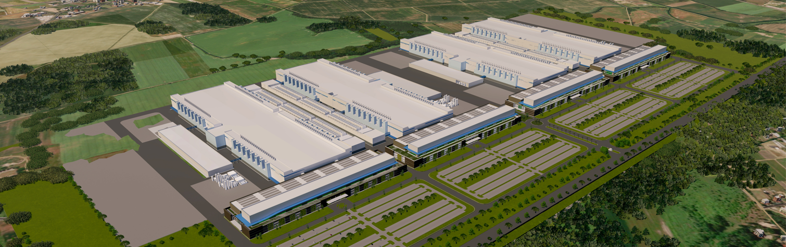
New York Investment
Preliminary illustration, subject to change
Preliminary illustration, subject to change
Four-fab manufacturing complex; up to $100B investment planned over the next 20+ years
Approximately 9,000 Micron jobs, 4,500 construction jobs and over 40,000 indirect jobs
Construction target early CY25 → Output in CY28
Preliminary design, permitting applications and environmental reviews underway
Notes:
Scott

Slide 10
The Community Investment Fund
$250m
from Micron
$500 million
over 20 years
$100m
from ESD
CATEGORIES OF SPENDING
$150m
from philanthropy & other partners
Workforce Development
Education
Community Investments
Housing

Slide 11
The CIF Application Process
Phase 1: Letter of Intent
Phase 2: Full Application
Single point of entry for all CIF project proposals.
Open to the public.
Reviewed by both ESD and Micron.
ESD/Micron invite relevant projects to submit Full Applications.
Available only by invitation from ESD and/or Micron after reviewing a Letter of Intent.
Submitted via ESD’s Consolidated Funding Application portal.
CNY Regional Office to provide technical assistance if needed.

Slide 12
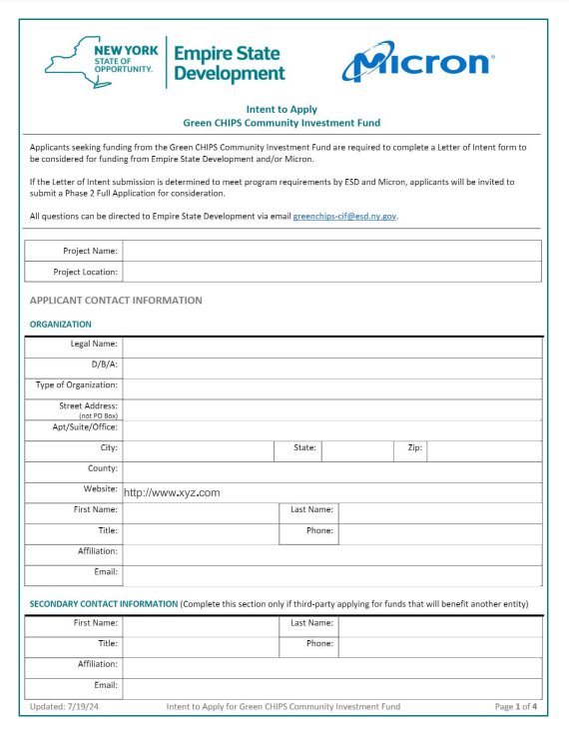
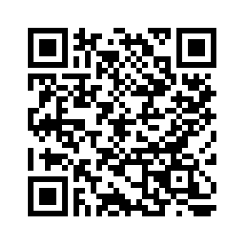
Phase 1: About the Letter of Intent
Letters of Intent will be available for submission on August 15th
Visit ESD’s website for more information:
https://esd.ny.gov/green-chips-community-investment-fund

Slide 13
Phase 1: About the Letter of Intent
A fillable PDF available on the ESD website.
Reviewed by both ESD and Micron.
All CIF project proposals must first submit a Letter of Intent.

Slide 14
Phase 1: About the Letter of Intent
Will be reviewed for:
Alignment with the priorities, principles, and core considerations of the CPD.
Consideration of impact on diverse and disadvantaged populations
Applicants’ ability to execute the project.

Slide 15
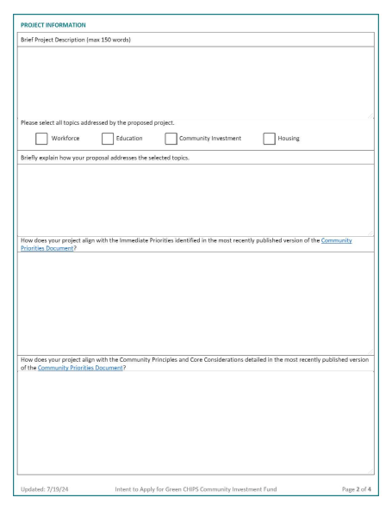
Phase 1: About the Letter of Intent
Letter of Intent Questions/Prompts
Project Description
Select topics addressed & explanation
Alignment with Immediate Priorities in the CPD
Alignment with Principles and Core Consideration in the CPD

Slide 16
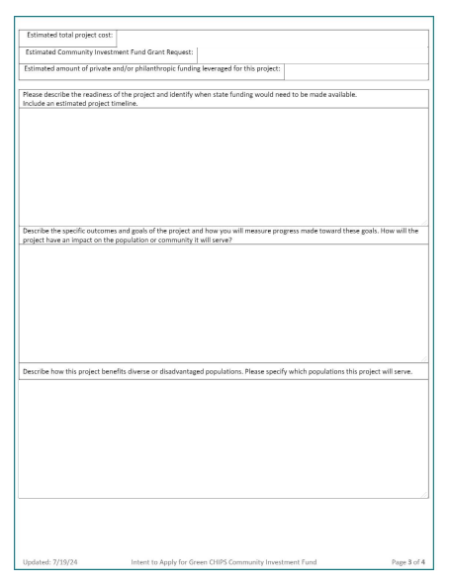
Phase 1: About the Letter of Intent
Letter of Intent Questions/Prompts
Estimated project cost, grant request, and leveraged funding
Readiness of the proposed project
Outcomes and goals of the project
Benefit to diverse and disadvantaged populations
Organization’s experience

Slide 17
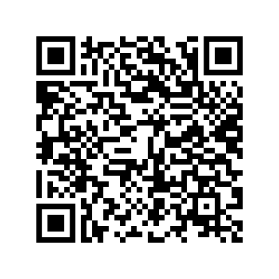
Community Investment Fund Program Requirements
Investments from ESD’s portion of the CIF will be available for capital-based projects.
ESD will consider grant requests over $100,000.
Generally, ESD will not consider funding more than 50% of a proposed project.
Micron portion of the CIF will be allocated on a case-by-case basis, with guidance from the CPD and in consultation with ESD.
See full program guidelines for more details:

Slide 18
Contact Information
Central New York Regional Office
315-897-5374
nys-centralny@esd.ny.gov
Joe Nehme
jnehme@micron.com
See full program guidelines for more details:

Slide 19
Green CHIPS Community Investment Fund Workshop
Access the CIF Program Page on ESD’s website:
August 2024

